Slide 1

CS552: Computer Graphics
Lecture 14: Raster Graphics and Scan Conversion

Slide 2
Recap
Rasterization
Scan converting lines
Bresenham’s Mid point line drawing algorithm

Slide 3
Objective
After completing this lecture students will be able to
Derive mathematical expression for drawing a circle
Write programs to implement circle drawing algorithm

Slide 4
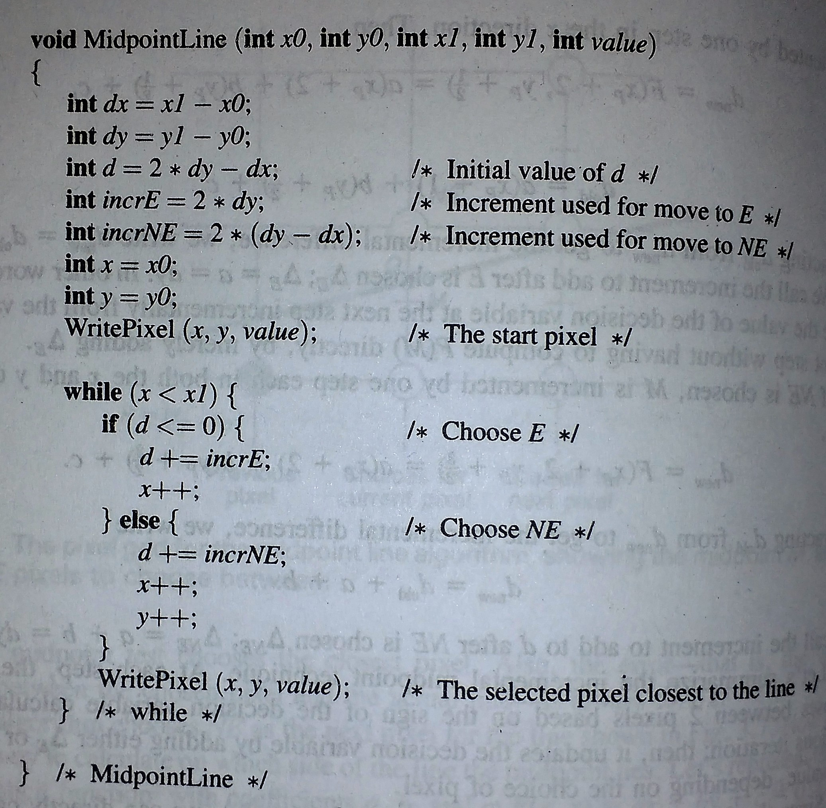
Mid point line drawing

Slide 5
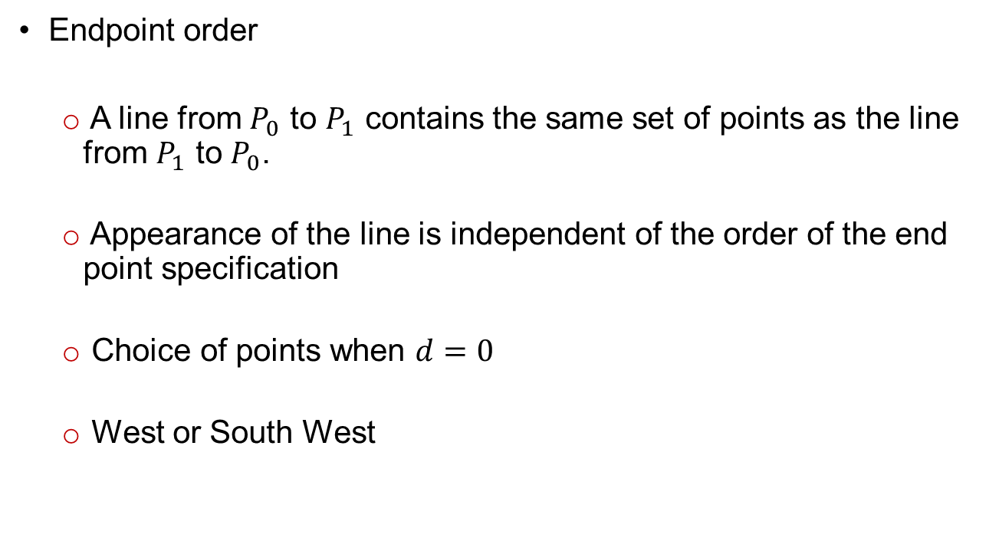
Additional Issues
Endpoint order
A line from $P_{0}$ to $P_{1}$ contains the same set of points as the line from $P_{1}$ to $P_{0}$.
Appearance of the line is independent of the order of the end point specification
Choice of points when $d=0$
West or South West

Slide 6
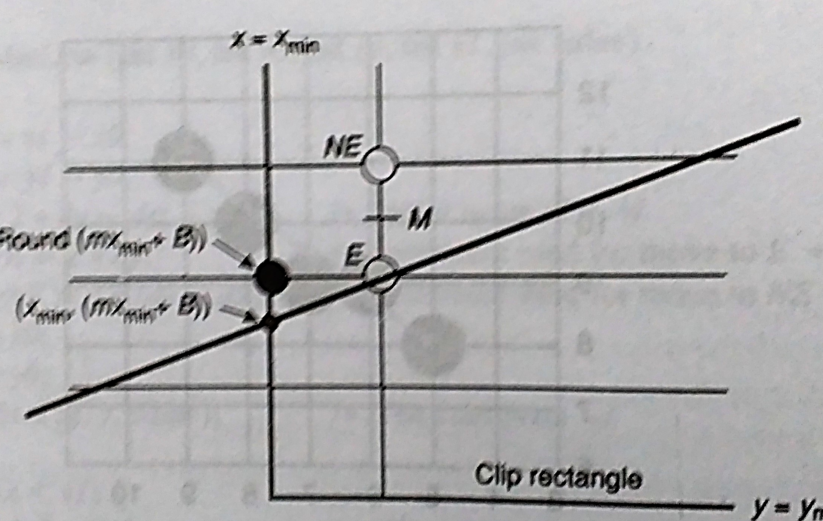
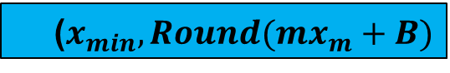
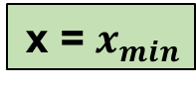
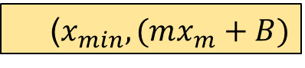
Additional Issues
Starting at the edge of a clip rectangle
Different slope ?
x = $x_{min}$
($x_{min},Round(mx_{m}+B)$
($x_{min},(mx_{m}+B)$
y = $y_{min}$

Slide 7
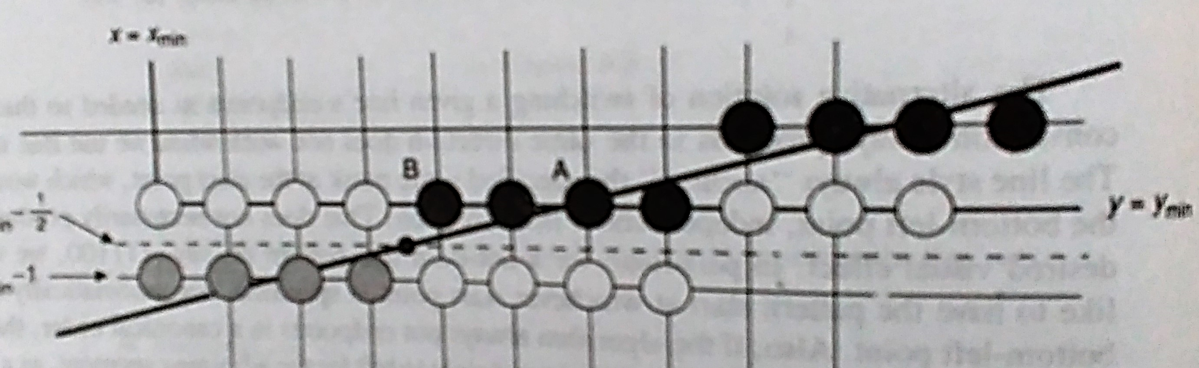
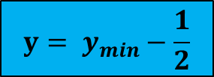
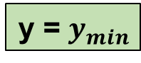
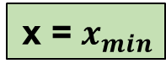
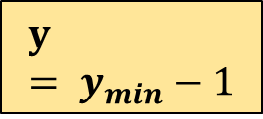
Additional Issues
Starting at the edge of a clip rectangle
Different slope ?
x = $x_{min}$
$$y= y_{min}−\frac{1}{2}$$
y = $y_{min}$
$$y= y_{min}−1$$

Slide 8
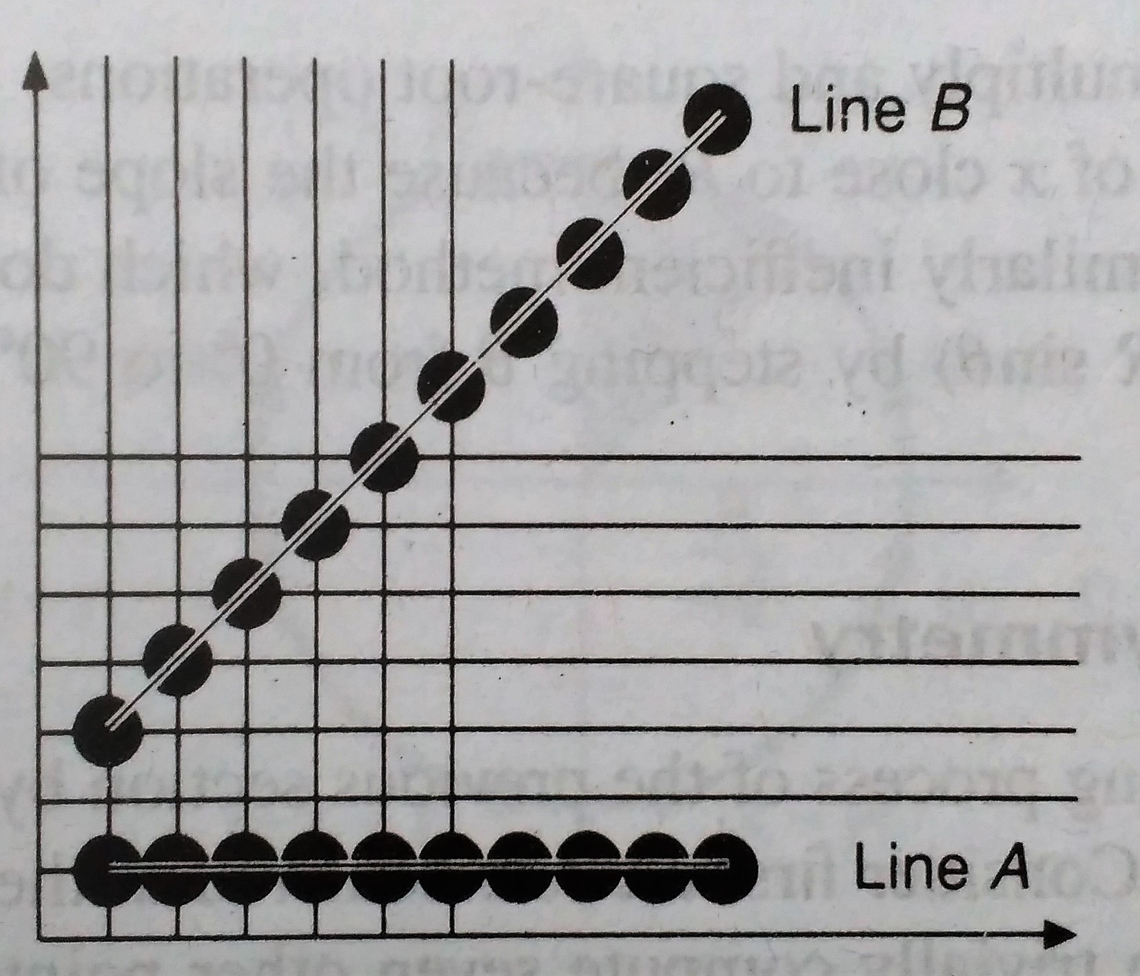
Additional Issues
Varying the intensity as a function of slope
Antialiasing
Line style

Slide 9
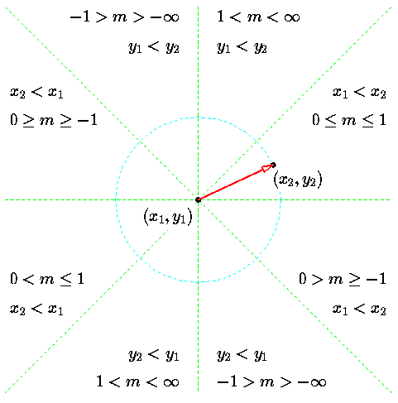
Generalization for different octants

Slide 10
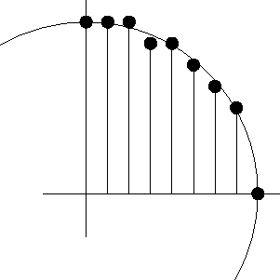
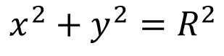
Scan converting a circle
A circle (through 0) with radius $R$ is given by the equation
$$x^{2}+y^{2}=R^{2}$$
What could be the naïve approach?
Ineffective
since it involves: squaring, taking roots and ROUND
it gives an asymmetric distribution.

Slide 11
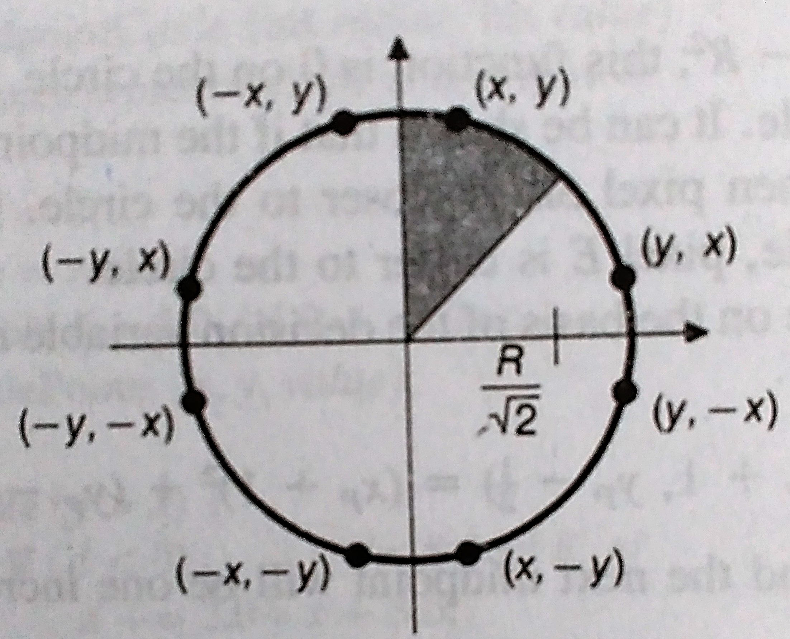
Eight fold symmetry
Only have to draw 1/8 of the circle

Slide 12
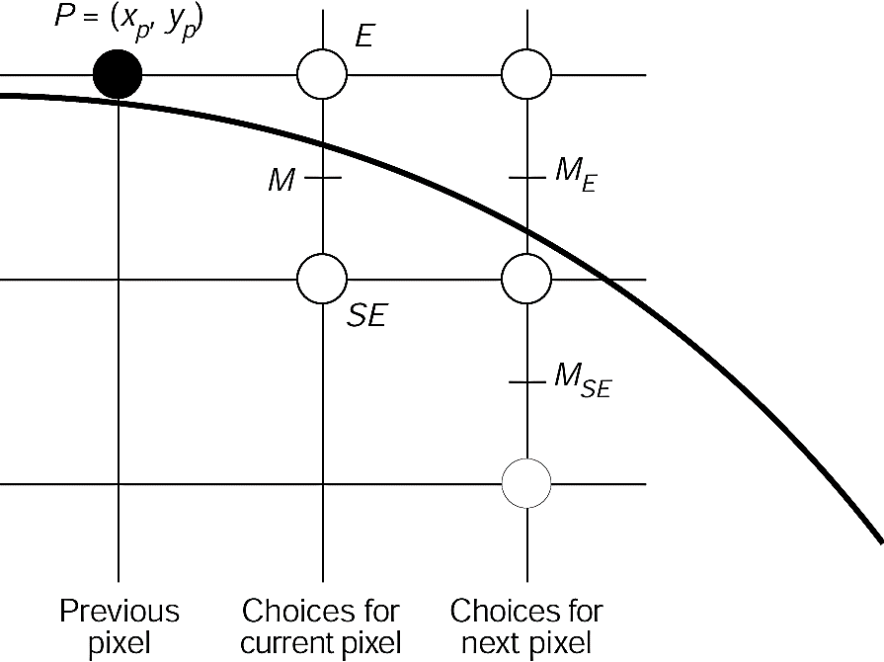
Midpoint Circle Algorithm

Slide 13
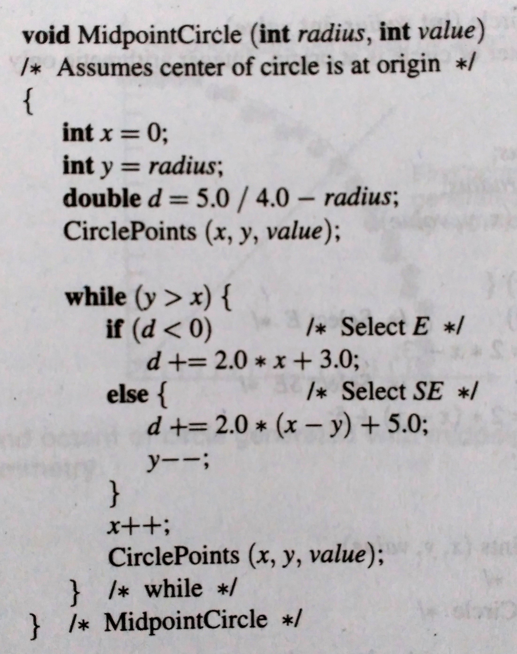
Circle Drawing Algorithm

Slide 14
Second order differences
Improve the performance of the midpoint algorithm
Incremental computational technique
Second order differences

Slide 15
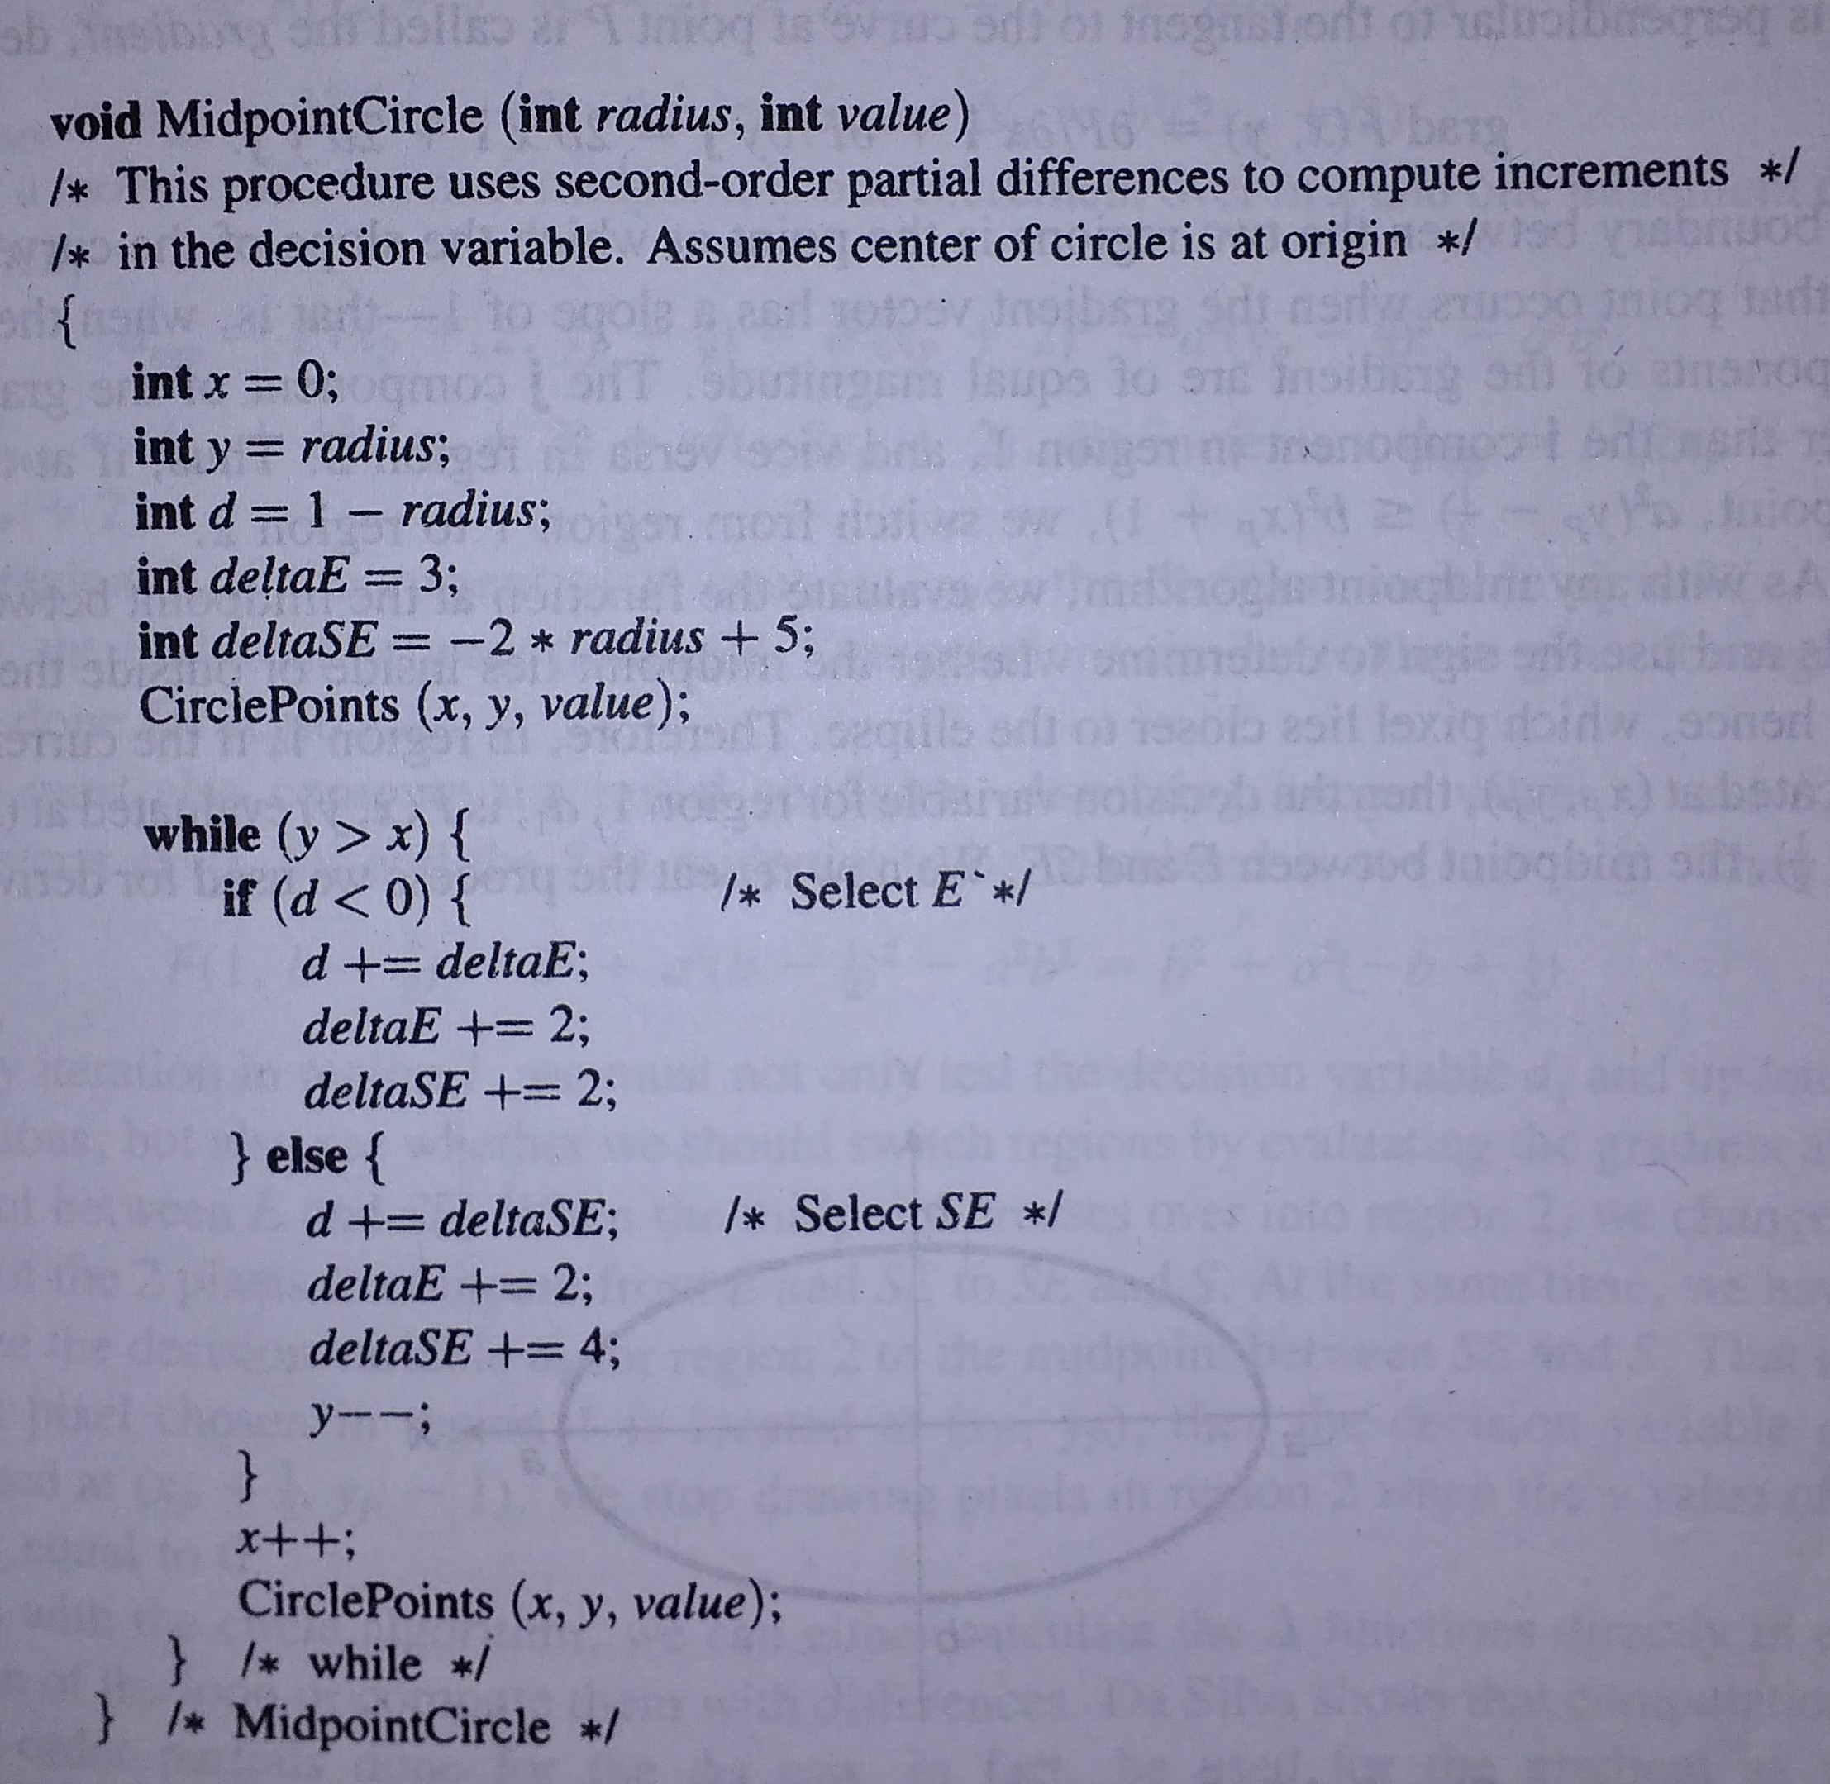
Improved algorithm

Slide 16
Thank you
Next Lecture: Scan converting Ellipse

